Slide 1
Market basket analysis using Association rules

Slide 2
Market basket analysis
Set of association rules that specify patterns of relationships among items in transactional data
Widespread use among retail stores.
Eg {peanut butter, jelly} -> {bread}
Groups of one or more items are surrounded by brackets to indicate that they form a set—itemset that appears in the data with some regularity.

Slide 3
Association rules
Association rules are not used for prediction, but rather for unsupervised knowledge discovery in large databases.
The downside, of course, is that there isn’t an easy way to objectively measure the performance of rule learner.
Have to evaluate rules for qualitative usefulness-typically an eyeball test.

Slide 4
Other applications
Patterns of DNA and protein sequences in analysis of cancer data
Patterns of purchases or claims that occur in combination with fraudulent credit card or insurance use
Identifying combinations of behavior that proceed customers dropping (upgrading) their subscription

Slide 5
Itemsets
For k items, there are on the order of 2^k possible itemsets that must be searched for rules.
By ignoring rare (and therefore perhaps less important) combinations, it is possible to limit the scope of the search for rules to a more manageable size.

Slide 6
Strengths
Is ideally suited for working with very large amounts of transactional data
Results in rules that are easy to understand
Useful for "data mining" and discovering unexpected knowledge in databases.
Weaknesses
Not very helpful for small datasets
Takes effort to separate the insight from the common sense
Easy to draw spurious conclusions from random patterns

Slide 7
Apriori
the Apriori algorithm employs a simple a priori belief as guideline for reducing the association rule search space: all subsets of a frequent itemset must also be frequent.
This heuristic is known as the Apriori property.
Using this astute observation, it is possible to dramatically limit the number of rules to search.

Slide 8
Support of an itemset or rule measures how frequently it occurs in the data.
Support(X) = count(X)/N
N is the no. of transactions in the database, and count(X) is the no. of transactions the itemset appears in
Eg support(flowers) = 4/5 = 0.75
Calculate support(get well card, flowers), support (get well card)
Transaction number | Purchased items
1 | {flowers, get well card, soda}
2 | {plush toy bear, flowers, balloons, candy bar}
3 | {get well card, candy bar, flowers}
4 | {plush toy bear, balloons, soda}
5 | {flowers, get well card, soda}

Slide 9
Confidence in a rule
A rule’s confidence is a measurement of its predictive power or accuracy
confidence (X→Y) = support(X,Y) / support(X)
Confidence tells us the proportion of transactions where the presence of item or itemset X results in the presence of item or itemset Y.
confidence(X→Y) ≠ confidence(Y→X)
Calculate confidence of {flower} → {get well card} and {get well card} → {flower}
{get well card} → {flower} is a strong rule since it has high support and confidence.

Slide 10
Building a set of rules with the Apriori principle
2 phases:
Identifying all itemsets that meet a minimum support threshold.
Iteration1 involves evaluating the set of 1-item itemsets (1-itemsets), iteration 2 evaluates the 2-itemsets and so on.
The result of each iteration i is a set of all i-itemsets that meet the minimum support threshold.
If {D} does not appear with desired support threshold but {A}, {B}, and {C} do, we may only consider {A, B}, {B, C}, and {A, C}. There is no reason to consider all 6 combinations. Thus sets containing D are eliminated a priori.
If {A, C} does not meet minimum threshold criterion, what next?
Creating rules from these itemsets that meet a minimum confidence threshold.
{A, B} would result in candidates {A}→{B} and {B}→{A}. Any candidate rules that do not meet the desired confidence level are eliminated.

Slide 11
Class Exercise
http://www.packtpub.com/code_download/13251
Download data and code from the above link. This is Ch8 from the book: “Machine learning with R”.
Data is real purchase data from a month of operation at a grocery store
9835 data points, or about 327 transactions per day
Open R-commander to upload the csv file from above.

Slide 12
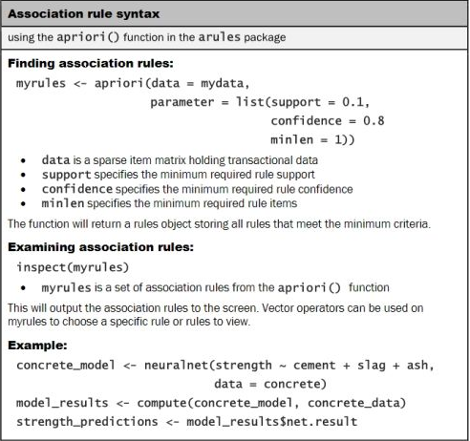

Slide 13
Datatype--Sparse Matrix
Reading normal csv is problematic
Making every item as a column makes the matrix/data frame really big and it quickly runs out of memory.
Sparse matrix is a datatype in which each item is stored as a column, and only the cells that got values are stored.
Thus sparse matrix is much more memory efficient than an equivalently sized matrix or data frame.

Slide 14
Summary statistics from sparse matrix
The density value of 0.02609146 (2.6 percent) refers to the proportion of non-zero matrix cells.
Since there are 9835 * 169 = 1662115 positions in the matrix, we can calculate that a total of 1662115 * 0.02609146 = 43367 items were purchased during the store's 30 days of operation (assuming no duplicate items were purchased).
Average transaction contained 43367 / 9835 = 4.409 different grocery items.

Slide 15
Arules
Items in sparse matrix are sorted in columns by alphabetical order
Inspect() to look at the contents of the sparse matrix. It can be used in combination with vector operators.
itemFrequency() allows you to see the proportion of transactions that contain an item.
itemFrequencyPlot() allows you to produce at a bar chart depicting the proportion of transactions containing certain items. Shows the support.
Image() can be a useful tool for exploring the data. For one, it may help with the identification of potential data issues. eg Columns that are filled all the way down could indicate items that are purchased in every transaction— a problem that could arise, perhaps, if a retailer's name or identification number was inadvertently included in the transaction dataset.

Slide 16
Support and confidence limits
The default support of 0.1. Since only eight items appeared this frequently in our data, it's no wonder we didn't find any rules when we didn’t specify support limit.
Support can be set based on the minimum number of transactions to happen in a day before you would consider a pattern interesting.
Low confidence leads to many unreliable rules—such as dozens of rules including items commonly purchased with batteries.
High confidence leads to obvious or inevitable rules—such as a smoke detector is always purchased in combination with batteries.

Slide 17
Lift
Lift is a measure of how much more likely one item is to be purchased relative to its typical purchase rate, given that you know another item has been purchased.
lift(X→Y) = confidence(X→Y) / support(Y)
lift(X→Y) = lift(Y→X). Validate it?
Lift values greater than 1 suggests that items are found together more often than chance occurrence.
Note: different from the lift in lift charts. There we were interested in measuring how many of good-prospects we would cover by including next ten percentile of prospects suggested by model.

Slide 18
Subset() in arules package
The keyword items, matches an item appearing anywhere in the rule. To limit the subset to where the match occurs only on the left or right-hand side, use lhs and rhs instead.
%in% means that at least one of the items must be found in the list you defined. If you wanted any rules matching either berries or yogurt, you could write items %in% c(" berries", "yogurt").
Additional operators are available for partial matching (%pin%) and complete matching (%ain%). Partial matching allows you to find both citrus fruit and tropical fruit using one search: items %pin% "fruit". Complete matching requires that all listed items are present. For instance, items %ain% c(" berries", "yogurt") finds only rules with both berries and yogurt.
Subsets can also be limited by support, confidence, or lift. For instance, confidence > 0.50 would limit you to rules with confidence greater than 50 percent.

